Slide 1

Smart Health
Team: The Mavericks
TeamNumber: 7

Slide 2

Motivation
Save time of Doctor and Patient
Get prescription through chat
Auto prescription for minor issues

Slide 3
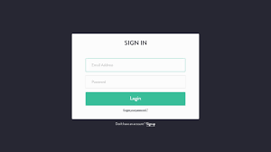
Increment-1
Create Login page and Register page for both doctor and as well as patient
Create their own individual Dashboard

Slide 4

Increment-2
Create chat application for the interaction between Doctor and patient
Manage Queue for the Doctor(i.e., only one patient can chat at a time)

Slide 5
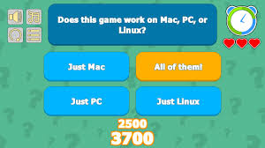
Increment-3
In case of emergency, by single click the patient should get the directions of the nearest hospital
Quiz Game about proteins in the items

